Slide 1
Ques solve on 2021
OS

Slide 2
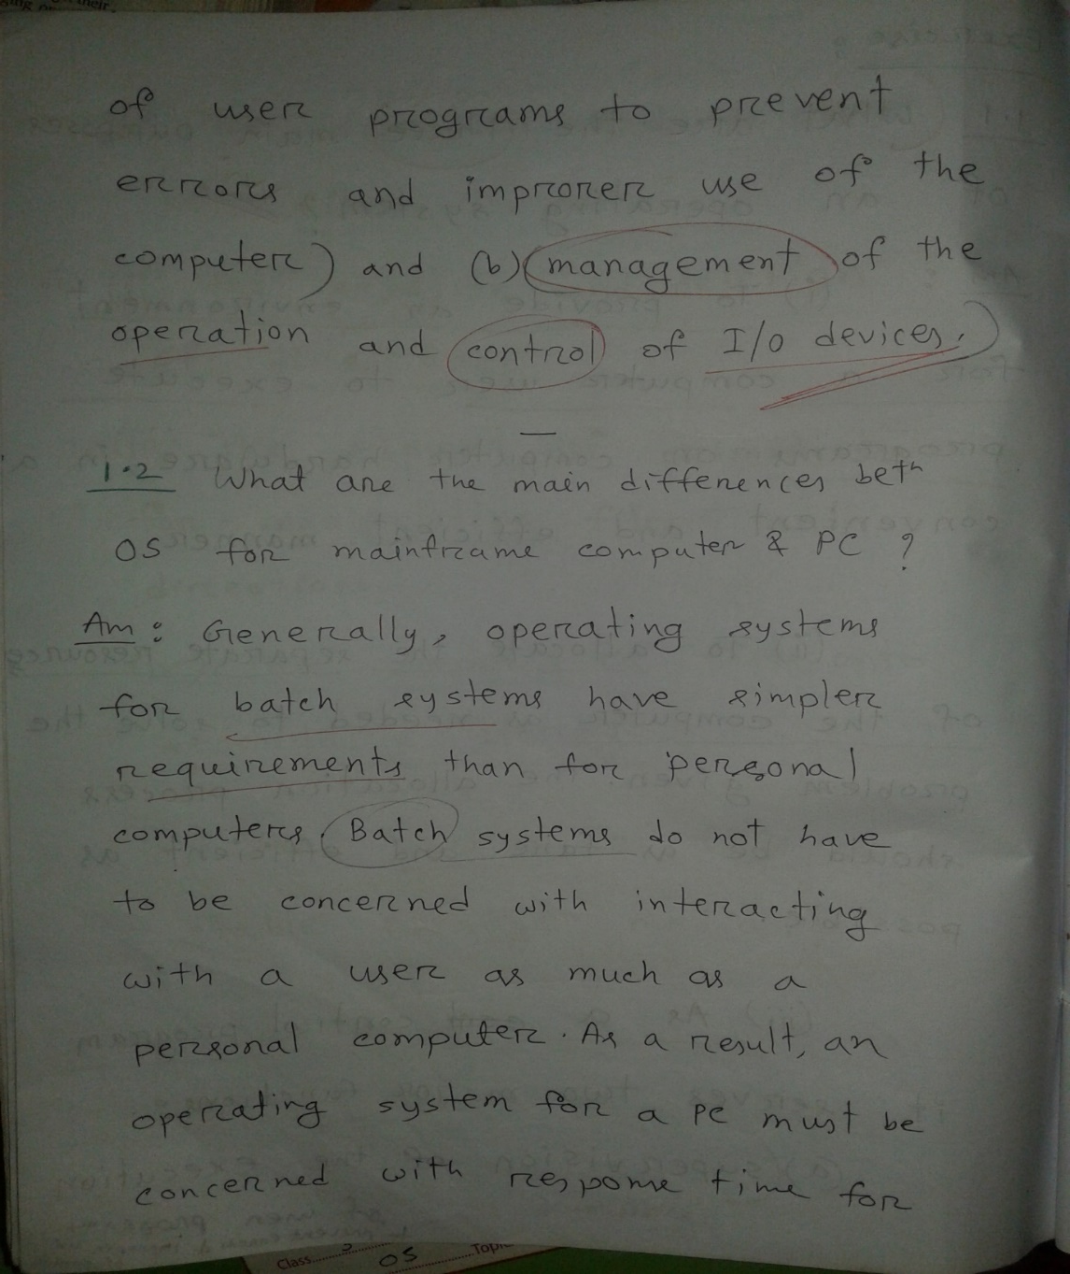
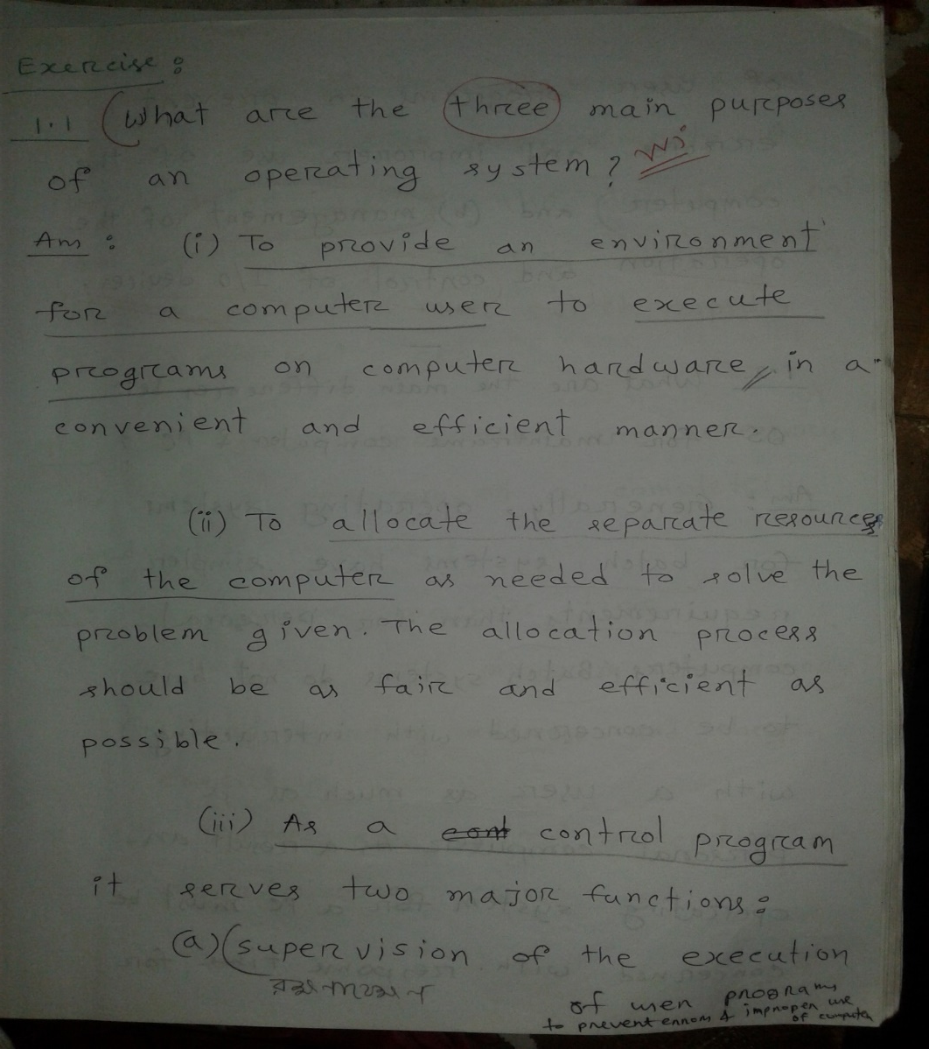
1.a.Definition 2022 sal theke
Three main purpose of OS:

Slide 3
Short note:
An operating system (OS) acts as a resource manager for a computer. It manages and allocates resources like the CPU, memory, storage, and input/output devices to various programs and processes. By efficiently handling these resources, the OS ensures that each program runs smoothly without conflicts, optimizing the overall performance of the system. In essence, the OS is like a coordinator that organizes and distributes the computer's resources to meet the needs of different applications and users.
b.2022 sal er b

Slide 4
c. Distributed operating system:
In a Distributed Operating System, we have various systems and all these systems have their own CPU, main memory, secondary memory, and resources. These systems are connected to each other using a shared communication network. Here, each system can perform its task individually. The best part about these Distributed Operating System is remote access i.e. one user can access the data of the other system and can work accordingly. So, remote access is possible in these distributed Operating Systems. The following image shows the working of a Distributed Operating System. #AdvantagesOfDistributedOperatingSystem
Since the systems are connected with each other so, the failure of one system can't stop the execution of processes because other systems can do the execution.
2. Resources are shared between each other.
3. The load on the host computer gets distributed and this, in turn, increases the efficiency. #DisadvantagesDistributedOperatingSystem
1. Since the data is shared among all the computers, so to make the data secure and accessible to few computers, you need to put some extra efforts.
2. If there is a problem in the communication network then the whole communication will be broken. (Disadvantage chay ni tao matburi kore dilam)

Slide 5
2.a. Peer-to-peer (P2P) systems and client-server systems are two different models for network communication and resource sharing. Each has its own advantages and disadvantages. Here are some advantages of P2P systems over client-server systems in the context of operating systems:
Decentralization:
P2P: There is no central server in a peer-to-peer network, which means that no single point of failure exists. This makes the system more robust and less vulnerable to outages or attacks that might affect a central server.
Client-Server: In contrast, client-server systems rely on a central server. If the server goes down, the whole network can become inaccessible.
Scalability:
P2P: Peer-to-peer networks can easily scale as more peers join the network. Each peer contributes resources (like bandwidth, storage, and processing power), which can improve the overall performance as the network grows.
Client-Server: In a client-server model, the server needs to handle all the requests from clients. As the number of clients increases, the server can become a bottleneck, requiring expensive upgrades to maintain performance.
Cost Efficiency:
P2P: P2P systems do not require dedicated servers, reducing the costs associated with maintaining a central server. Peers share their resources, leading to lower overall costs.
Client-Server: Running a client-server network typically requires investment in high-performance server hardware and maintenance, which can be costly.
Resource Sharing:
P2P: In P2P systems, each peer can share resources directly with other peers. This direct sharing can be more efficient and flexible, as peers can share files, bandwidth, and processing power without relying on a central server.
Client-Server: In a client-server system, resource sharing is typically mediated through the server, which can introduce delays and require more complex management.
These advantages make P2P systems particularly suitable for applications where decentralization, scalability, and cost efficiency are important, such as file sharing, blockchain, and distributed computing.

Slide 6
b. differences between symmetric and asymmetric multiprocessing?
Answer: Symmetric multiprocessing (SMP) and asymmetric multiprocessing (AMP) are two different approaches to using multiple processors in a computer system. Here are the key differences between them:
Processor Roles:
Symmetric Multiprocessing (SMP): In SMP, all processors are identical and have equal access to memory and I/O devices. Each processor runs its own task, and they all share the same memory and operating system. Any processor can perform any task, and the load is evenly distributed among all processors.
Asymmetric Multiprocessing (AMP): In AMP, processors are not equal. One processor (often called the master) controls the system and assigns tasks to the other processors (called slaves). The master processor typically runs the operating system, while the slave processors handle specific tasks or workloads assigned by the master.
Memory Access:
SMP: All processors share the same physical memory, and each processor can access all memory locations. This shared memory architecture allows for easier communication and data sharing between processors.
AMP: Memory may be divided among processors, with each processor potentially having its own private memory. In some AMP systems, only the master processor has access to all memory, while the slave processors have access to their own local memory and only certain shared resources.
Task Scheduling:
SMP: The operating system's scheduler can assign any task to any processor. Since all processors are equal, the scheduler can dynamically balance the load by distributing tasks evenly among the processors.
AMP: The master processor is responsible for scheduling tasks and assigning them to the slave processors. The scheduling is typically static, with specific tasks assigned to specific processors.

Slide 7
Complexity:
SMP: SMP systems are generally simpler to design and implement, as all processors are identical and share the same resources. The operating system and applications do not need to distinguish between processors.
AMP: AMP systems are more complex because they require careful coordination between the master and slave processors. Different processors may run different operating systems or specialized code, and the system must manage the communication between them.
Three advantages of multi processor system:(jeta kothin lage ,1 ta komay nis)
1.Since more than one processors are working at a time, so more work is done in a shorter period of time. Throughput will be increased.
2.We have more than one processor, so if one processor is not working then the job can be done with the help of other processors. This, in turn, increases reliability.
3. If you are providing lots of work on one processor then it will result in more battery drain. But if the work is divided into various processors then it will provide a better battery efficiency.
4. Multiprocessing is an example of true parallel processing i.e. more than one processes executing at the same time.
Disadvantages:(ques e 1 ta chaiche)
• As more than processors are working at a particular instant of time. So, the coordination between these is very complex. • Since, the buses, memory, and I/O devices are shared. So, if some processors are using some I/O then another processor has to wait for its turn and this will result in the reduction of throughput.
• To have the efficient working of all the processors at a time, we need to have a large main memory and this, in turn, increase the cost.

Slide 8
c. #RealTimeOperatingSystem The Real-time Operating Systems are used in the situation where we are dealing with some real-time data. So, as soon as the data comes, the execution of the process should be done and there should be no dealy i.e. no buffer delays should be there. Real-time OS is a time-sharing system that is based on the concept of clock interrupt. So, whenever you want to process a large number of request in a very short period of time, then you should use Real-time Operating System. For example, the details of the temperature of the petroleum industry are very crucial and this should be done in real-time and in a very short period of time. A small delay can result in a life-death situation. So, this is done with the help of Real-time Operating System.
There are two types of Real-time Operating System:
#HardRealTime: In this type, a small delay can lead to drastic change. So, when the time constraint is very important then we use the Hard Real-time.
#SoftRealTime: Here, the time constraint is not that important but here also we are dealing with some real-time data.
#AdvantagesOfRealTimeOperatingSystem
There is maximum utilization of devices and resources.
2. These systems are almost error-free.
#DisadvantagesRealTimeOperatingSystem
The algorithms used in Real-time Operating System is very complex.
2. Specific device drivers are used for responding to the interrupts as soon as possible.

